Slide 1
#TeamOutLawsPresenting

Slide 2
We Seek out the Govt. Approved Guides to play host to travellers.

Slide 3
Idea
TripUsher app, is introducing a new travel concept that offers a solution for travellers looking to ditch the guidebooks and discover a historical places in city from a local's perspective with the help of Generous Guide.
We Seek out the Govt. Approved Guides from IATO to play host to travellers.

Slide 4
Target Audience
Foreigner tourist.
People new to the diversity.
Traveller visiting historic destinations.
When language barriers are likely to be severe.
To hand off the logistics of travel.
Traveller with short itinerary.

Slide 5
Features
Splash Screen
Default Login provided for Traveller, on selecting the check-box. User can Login into app as a Guide
SignUp for Tourist and Certified Guide
Verification for both would be done on the basis of given contact number. SMS OTP would be generated.
Provide the region for which guide required. Currently, supporting for Delhi and Agra cities.
List down the famous area to visit for the selected region, Along with Top suggested Guide name.
Sent hire request to Guide, Escort would acknowledge the request. Contact detail would be shared. Payment settled mode Cash.
Tourist can set the preference for Guide, in terms of preferred language, Location, Price Range, Date & time, rating . List would display accordingly… Currently, supporting for Hindi and English language preference.
Guide setting screen would give a mode to set “Availability” as checked.
& Guide

Slide 6
Technology Driven
MongoDB
ExpressJS
ReactJS
NodeJS
Redux
Webpack
NancyFX
C#
Java
Android
TinyMCE
Docker

Slide 7
Implementation done so far…

Slide 8

Splash Screen

Slide 9
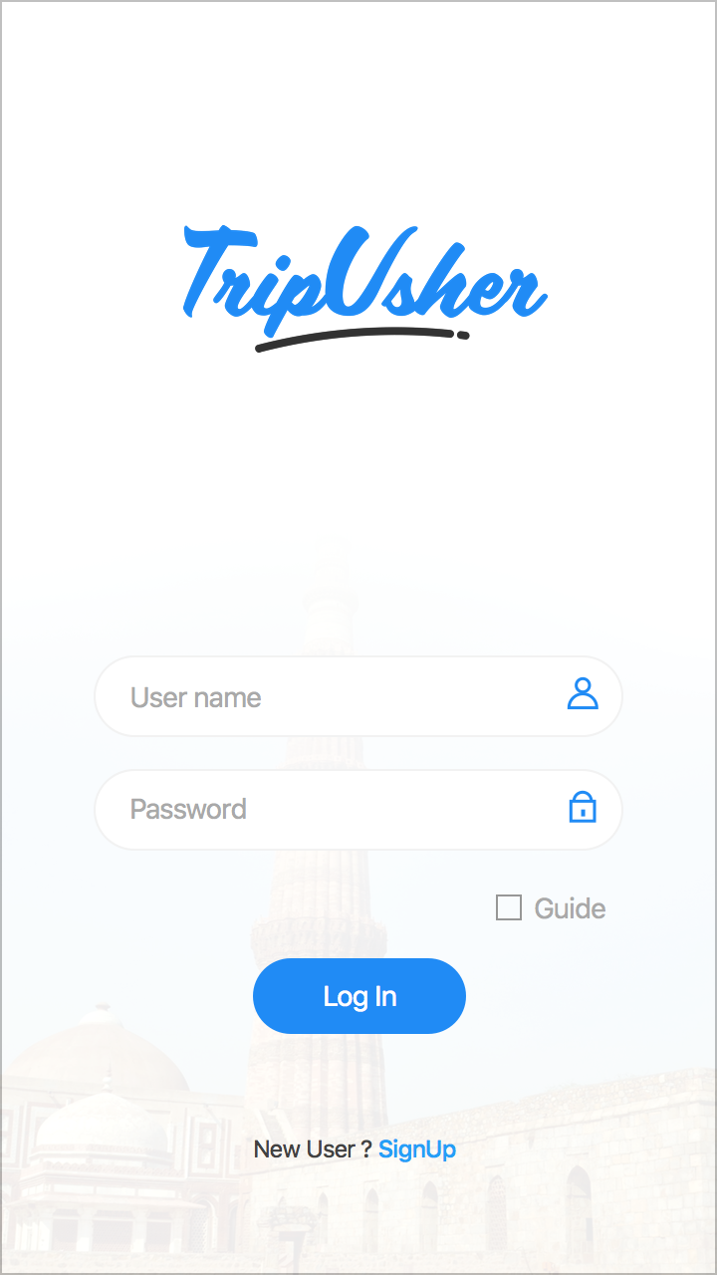
Tourist Login Screen

Slide 10
Login up screen for ~Tourist & Guide

Slide 11
Verification Screen for both Tourist or Guide.

Slide 12
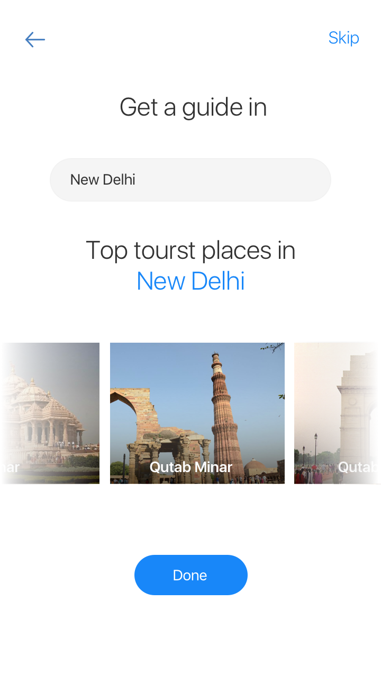
Need a guide for a region?

Slide 13
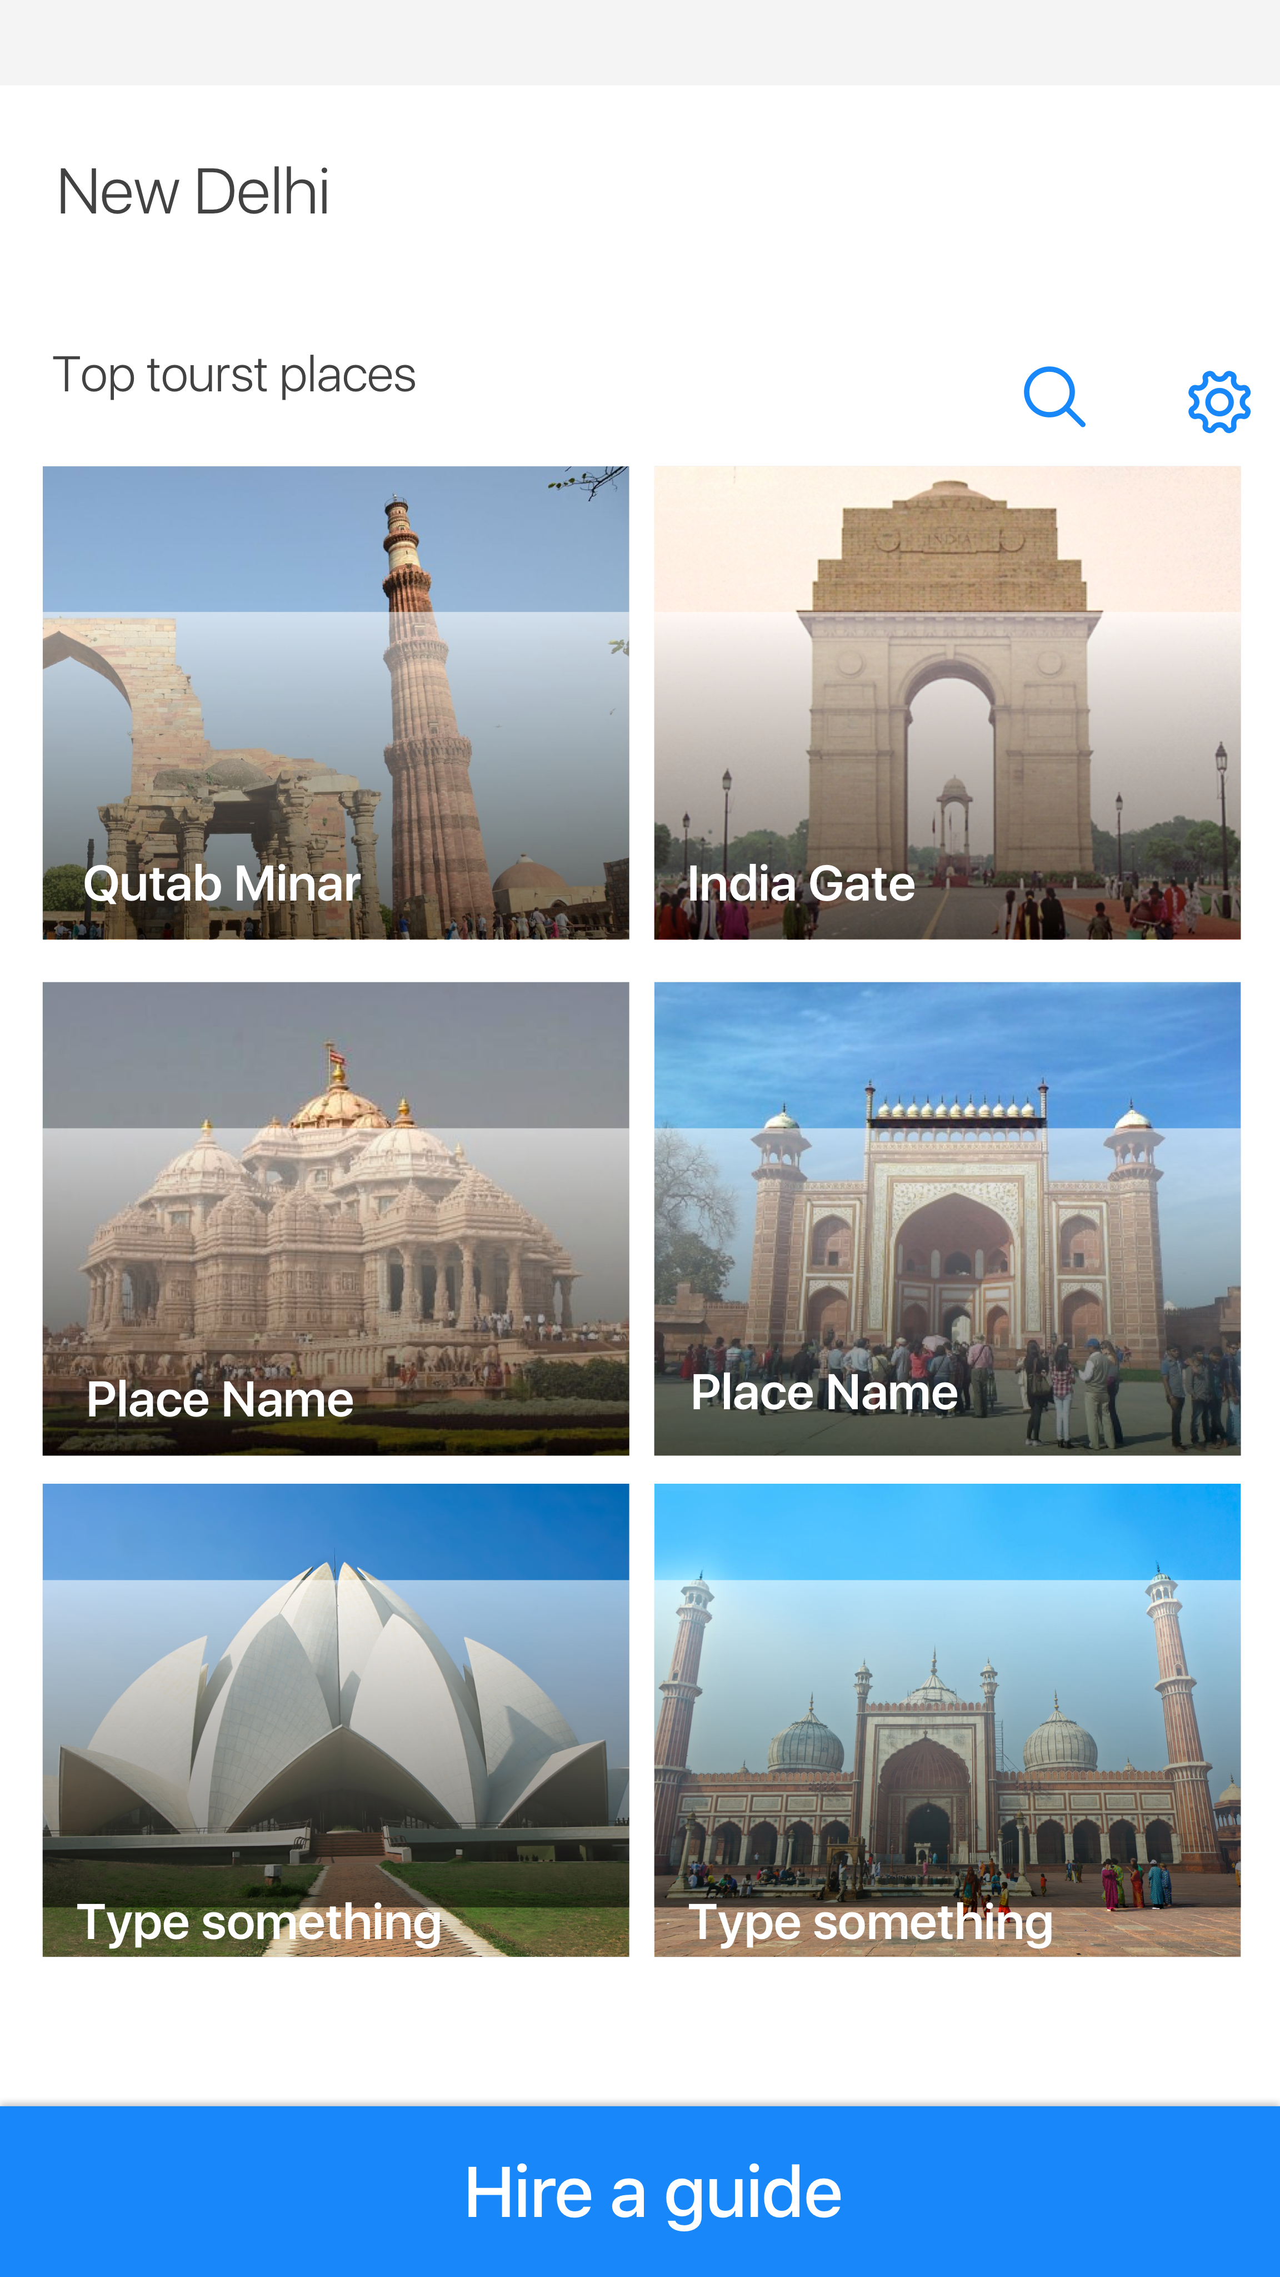
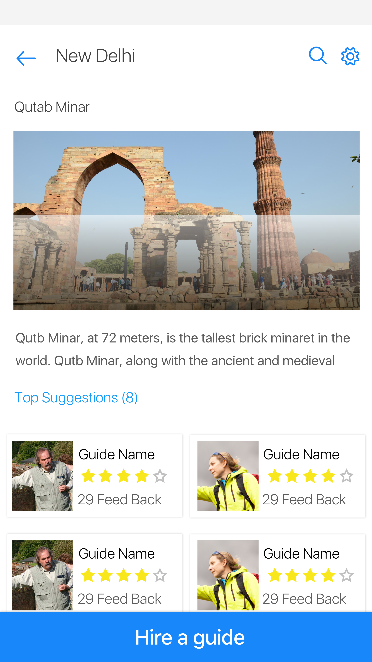
List down the famous area to visit for the selected region, Along with Top suggested Guide name.

Slide 14
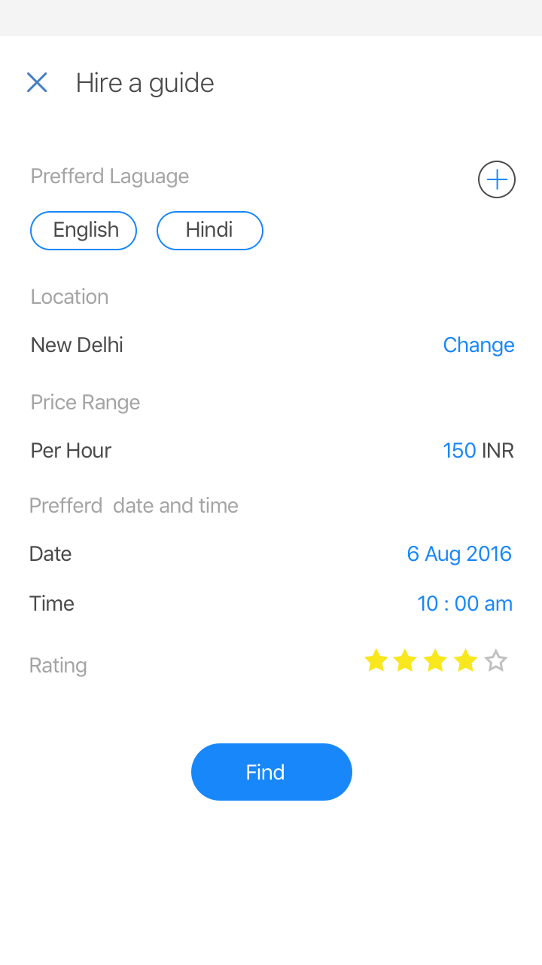
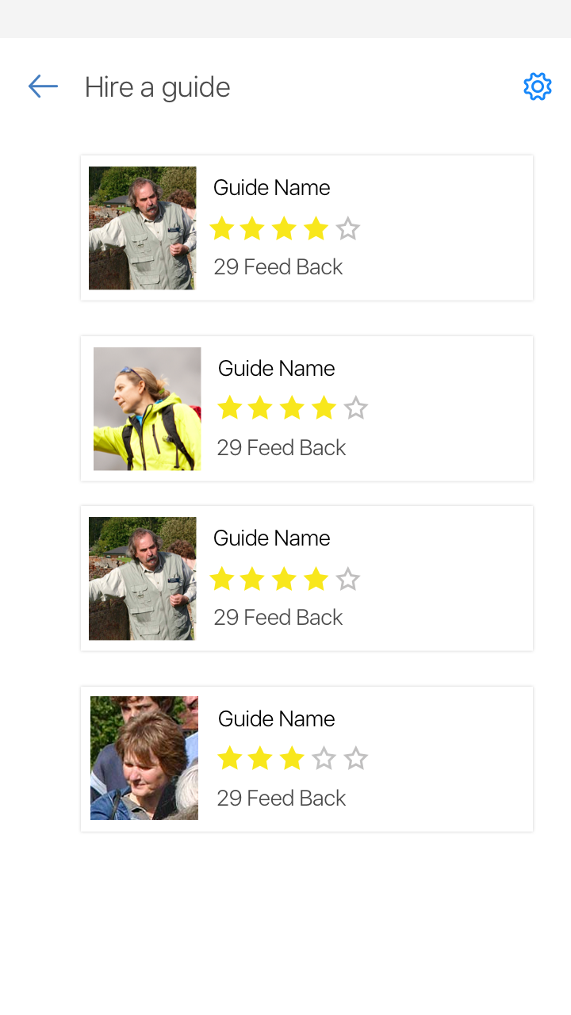
Tourist set the preference. Guide list display accordingly…

Slide 15
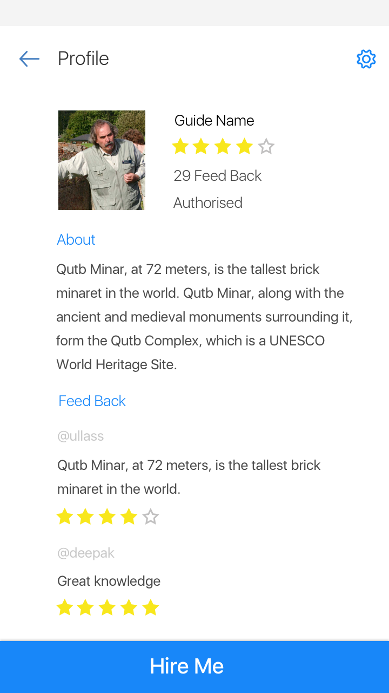
Glance @Guide’s profile

Slide 16
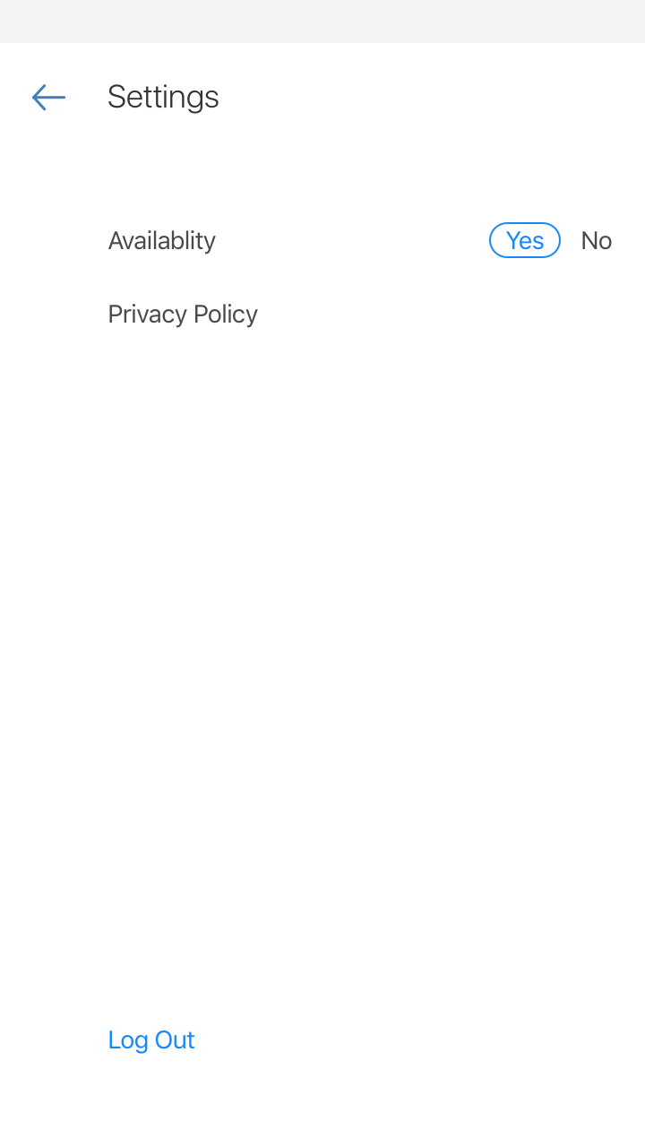
Guide setting screen

Slide 17
Future Implementation…
Guider two-step verification, under registration:
Guide Govt. proof upload feature
Get a guide in feature would pick Current Location.
Future booking can be done too.
Tourist can book a guide on basis on intervals(hours/days)
Guidebooks implementation will be done.
Feedback/Rating feature
SOS, Emergency Contact Feature
Customer Support

Slide 18
This is end of our tour.
Thank you ☺

Slide 19


